Slide 1
Budget Calculator

Slide 2
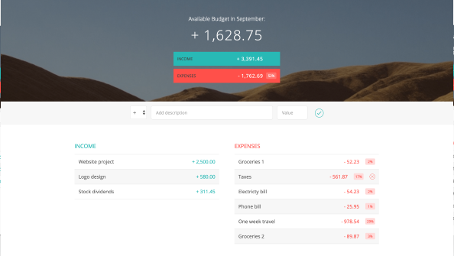
Budget Calculator

Slide 3
